Slide 1
Employee Data Analysis using Excel
STUDENT NAME:JEEVLIN MERCIA D
REGISTER NO:312212030
NM ID: 1888677D08C329DB622478726B0D414D
DEPARTMENT:COMMERCE
COLLEGE:MAR GREGORIOUS COLLEGE OF ARTS AND SCIENCE

Slide 2
PROJECT TITLE
Employee Performance Analysis using Excel

Slide 3


AGENDA
Problem Statement
Project Overview
End Users
Our Solution and Proposition
Dataset Description
Modelling Approach
Results and Discussion
Conclusion
3/21/2024 Annual Review

Slide 4

PROBLEM STATEMENT
To systematically evaluate and improve employee performance within an organization by leveraging Microsoft Excel as a tool for data analysis. The goal is to develop a comprehensive performance analysis model that facilitates data-driven decision-making and supports the organization's objectives of enhancing employee productivity and satisfaction.

Slide 5

PROJECT OVERVIEW
.
Develop a Performance Analysis Framework
Build Analytical Tools
Enhance Data Visualization
Provide Actionable Insights

Slide 6


WHO ARE THE END USERS?
EMPLOYEE
EMPLOYER
MANAGER

Slide 7

OUR SOLUTION AND ITS VALUE PROPOSITION
Conditional formatting
Filter-remove
Formula-performance
Pivot-summary
Graph-data visualization

Slide 8
Dataset Description
emloyee=-Kaggle
26-features
9-features
Employee id-num
Name-text
Employee type
gender-male female
employee rating-num

Slide 9

THE "WOW" IN OUR SOLUTION
PERFORMANCE=IFS(Z1>=5,”VERYHIGH”,Z1>=4,”HIGH”,Z1>=3,”MED”,TRUE,”LOW”)
3/21/2024 Annual Review
9

Slide 10
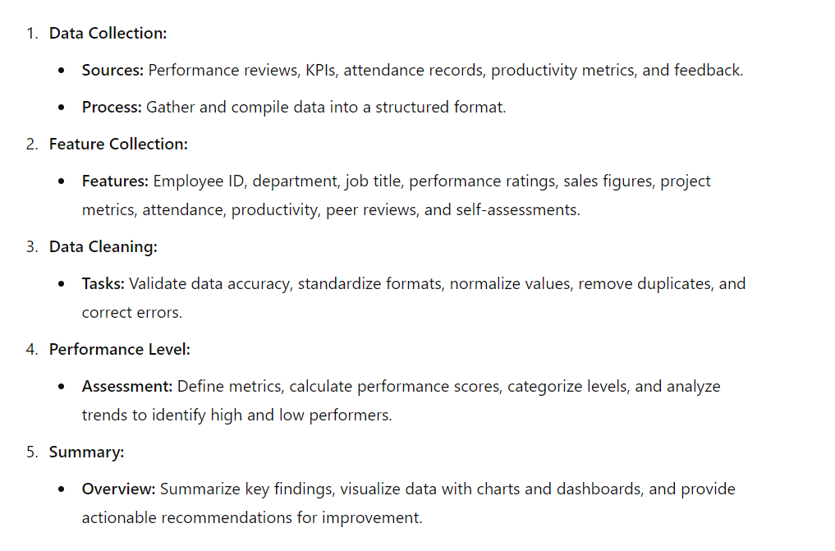
MODELLING
10

Slide 11
RESULTS
11

Slide 12
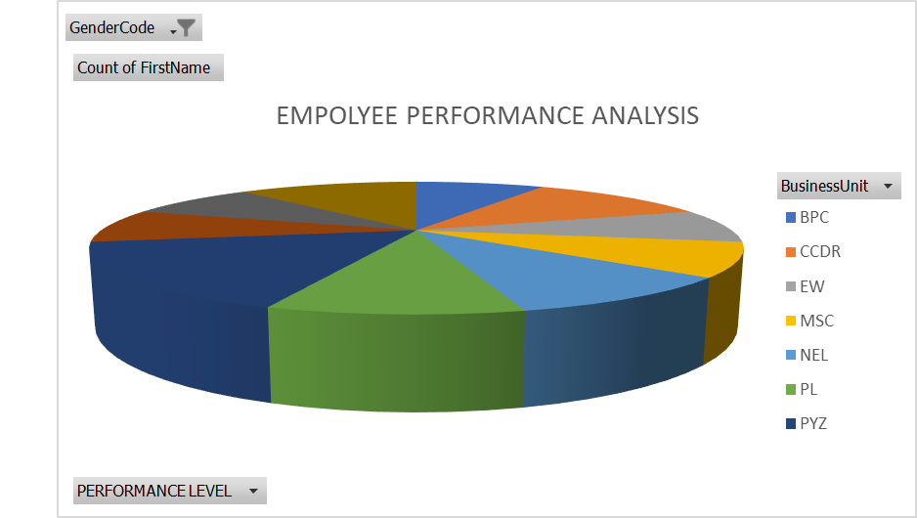
RESULT

Slide 13
conclusion
The "Employee Performance Analysis using Excel" project successfully leverages Microsoft Excel to provide a detailed, data-driven approach to evaluating and improving employee performance. By systematically collecting, cleaning, and analyzing performance data we executed the project.

